Slide 1
Unit 02: Voltage sag (6 hrs)
Origin of voltage sags and interruptions, voltage sag characteristics- magnitude, duration, phase angle jump, point on wave initiation and recovery, missing voltage.
Area of vulnerability, equipment behaviour under voltage sag, ITIC curve, voltage sag monitoring and mitigation techniques.

Slide 2
voltage sag and Interruptions
A voltage sag is a short-duration (typically 0.5 to 30 cycles) reduction in rms voltage caused by faults on the power system and the starting
of large loads, such as motors
Momentary interruptions (typically no more than 2 to 5 s) cause a complete loss of voltage and are a common result of the actions taken by utilities to clear transient faults on their systems. Sustained interruptions of longer than 1 min are generally due to permanent faults.

Slide 3
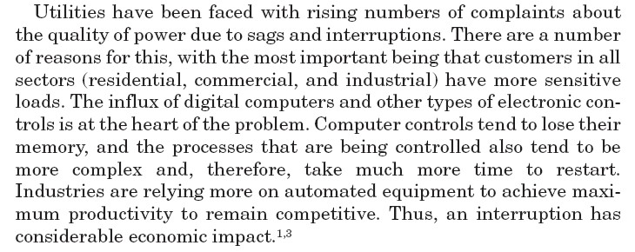

Slide 4
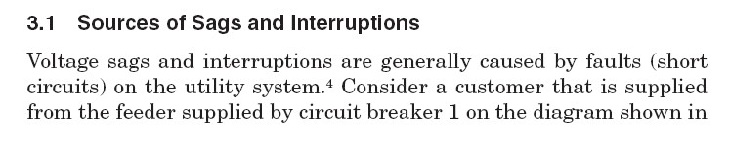
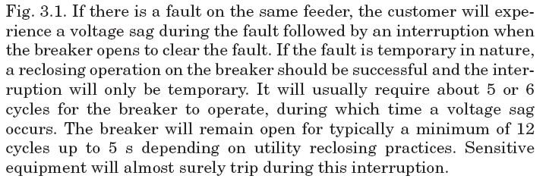

Slide 5
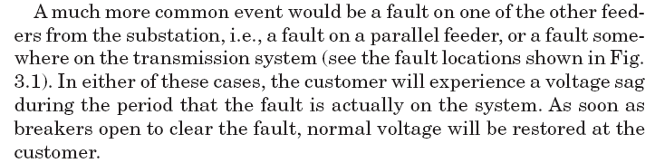

Slide 6
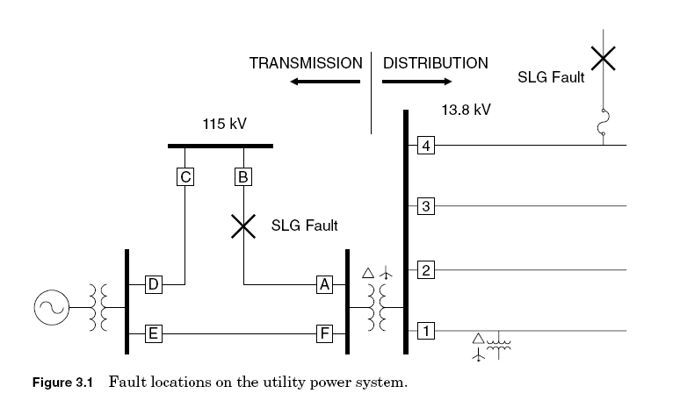
Explanation of SAG and Interruption

Slide 7
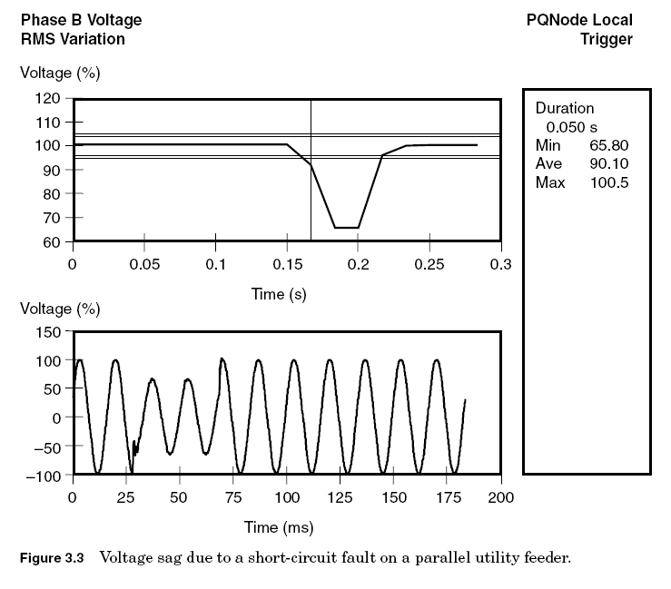

Slide 8
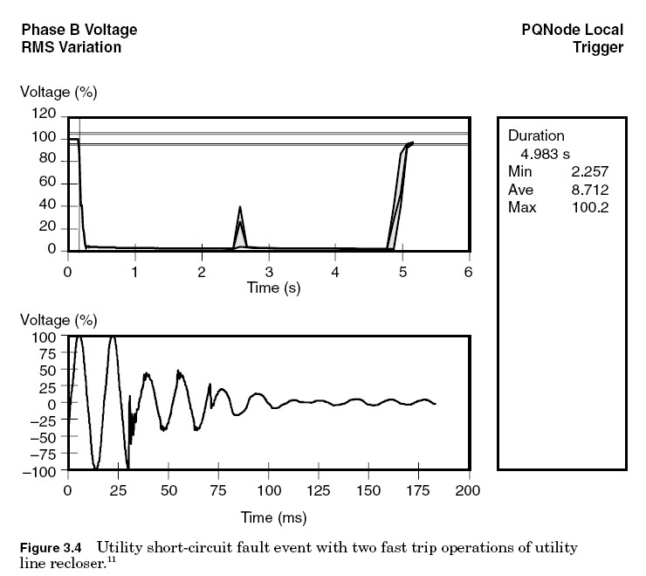

Slide 9
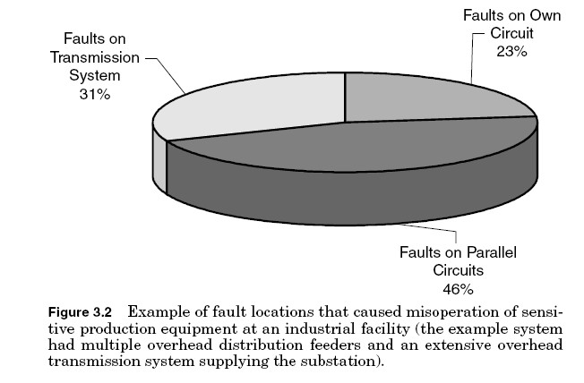
Sensitivity of Equipments according to
location of Fault.

Slide 10
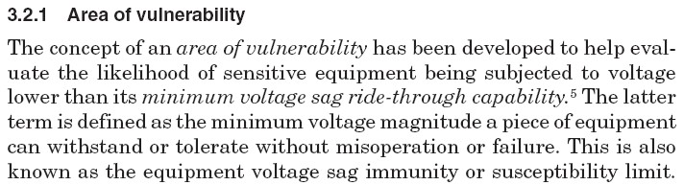
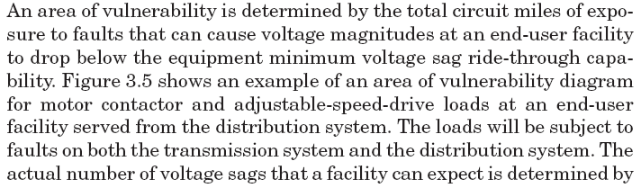

Slide 11
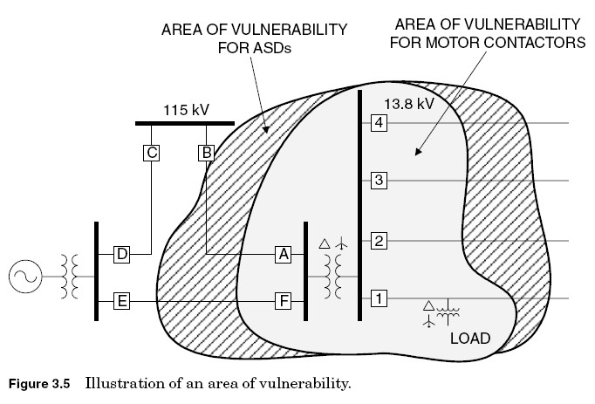

Slide 12
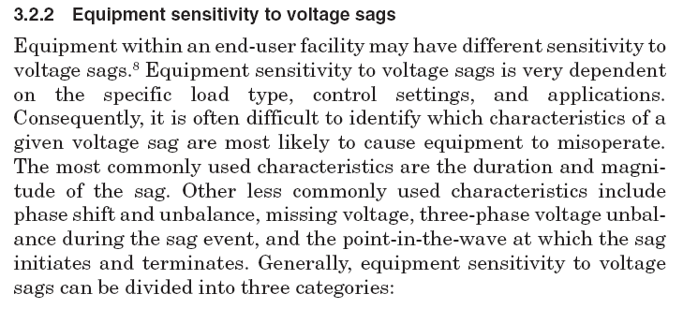

Slide 13
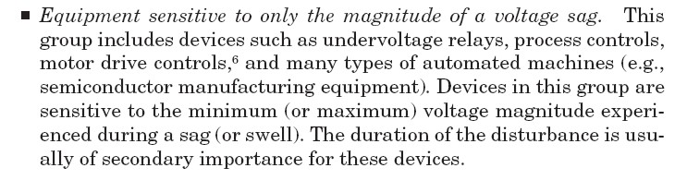

Slide 14
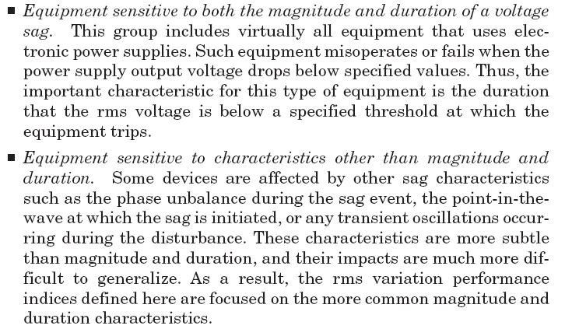

Slide 15
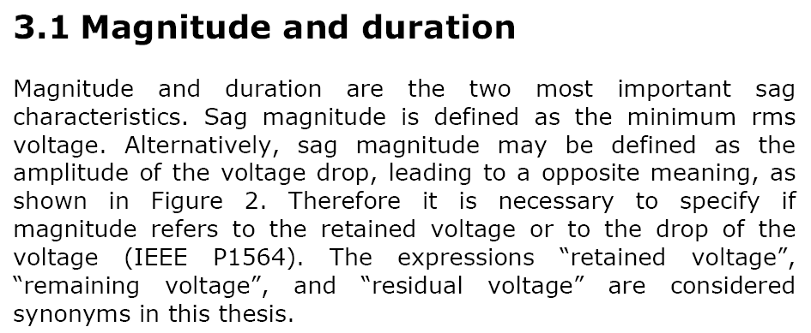
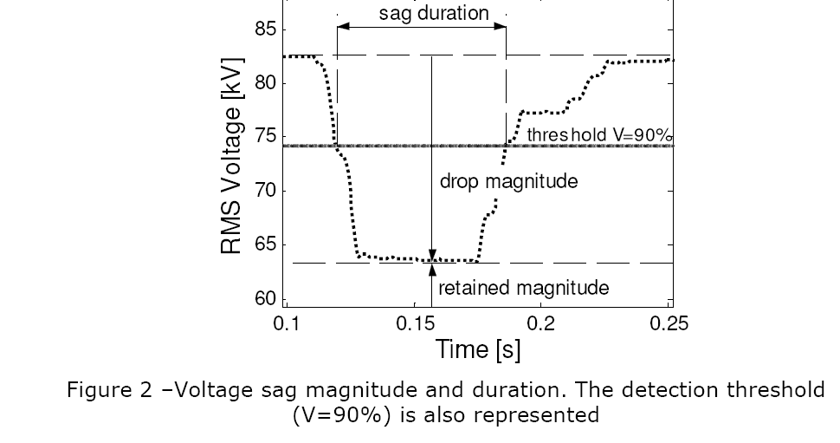

Slide 16
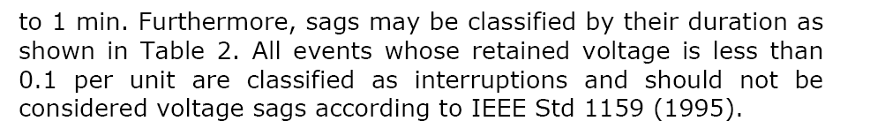

Slide 17
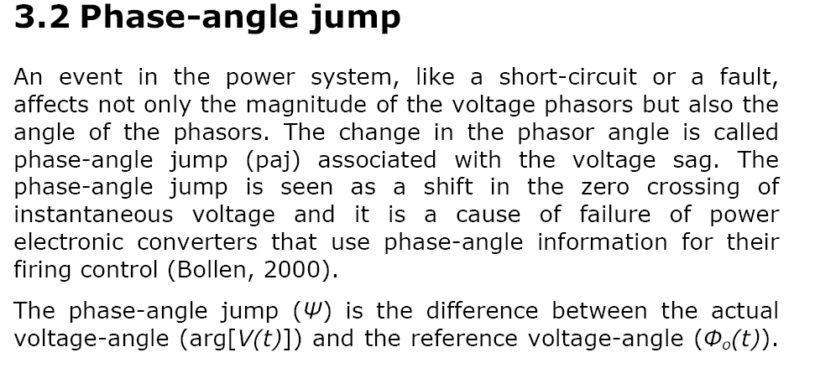
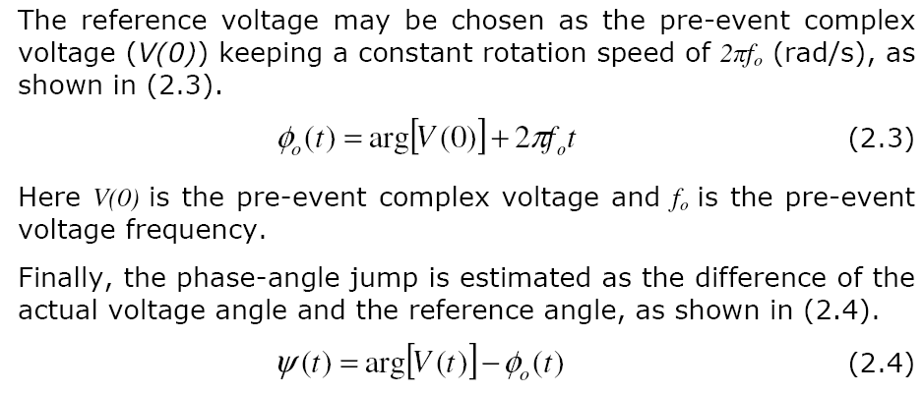

Slide 18
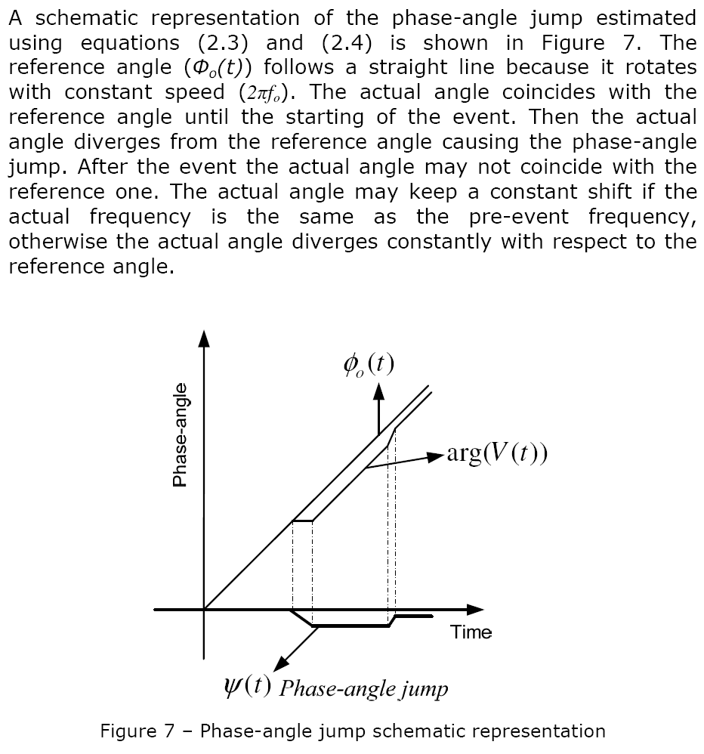

Slide 19
CBEMA and ITI Curves( Information Technology Industry counsel curve)
The CBEMA organization has been replaced by ITI,10 and a modified curve has been developed that specifically applies to common 120-V computer
equipment (see Fig. 2.16). The concept is similar to the CBEMA curve. Although developed for 120-V computer equipment, the curve has been applied to general power quality evaluation like its predecessor curve. Both curves are used as a reference in this book to define the withstand capability of various loads and devices for protection from power quality variations. For display of large quantities of power quality monitoring
data, we frequently add a third axis to the plot to denote the number of events within a certain predefined cell of magnitude and duration. If restricted to just the two-dimensional views shown in Fig.
2.16, the plot tends to turn into a solid mass of points over time, which
is not useful.

Slide 20
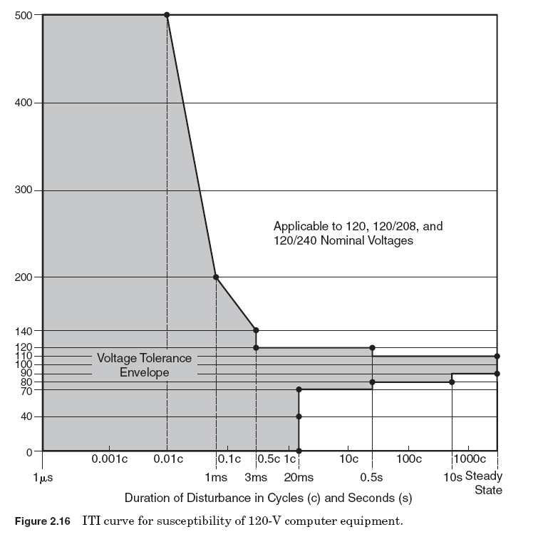

Slide 21
Voltage sag monitoring and mitigation techniques.
Solutions to improve the reliability and performance of a process or facility can be applied at many different levels. The different technologies available should be evaluated based on the specific requirements of the process to determine the optimum solution for improving the overall voltage sag performance

Slide 22
1. Ferroresonant transformers
1.Ferroresonant transformers, also called constant-voltage transformers (CVTs), can handle most voltage sag conditions.
2. Ferroresonant transformers are basically 1:1 transformers which are excited high on their saturation curves, thereby providing an output voltage which is not significantly affected by input voltage variations.
3. CVTs are especially attractive for constant, low-power loads.

Slide 23
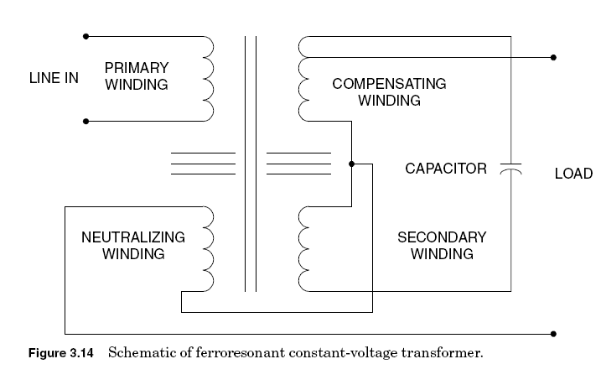
Circuit Diagram of CVT

Slide 24
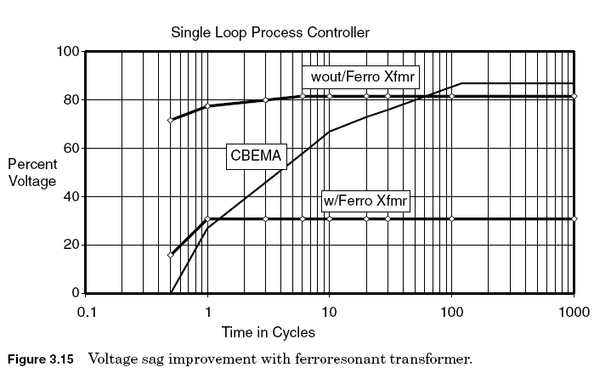
Figure 3.15 shows the voltage sag ride-through improvement of a process controller fed from a 120-VAferroresonant transformer. With the CVT, the process controller can ride through a voltage sag down to 30 percent of nominal, as opposed to 82 percent without one. Notice how the ride-through capability is held constant at a certain level. The reason for this is the small power requirement of the process controller, only 15 VA.

Slide 25
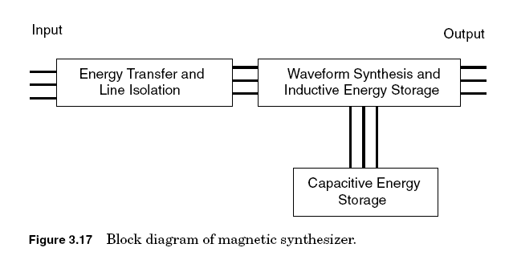
2 Magnetic synthesizers
1. Magnetic synthesizers use a similar operating principle to CVTs except they are three-phase devices and take advantage of the three-phase magnetics to provide improved voltage sag support and regulation for three-phase loads.

Slide 26
They are applicable over a size range from about 15 to 200 kVA and are typically applied for process loads of larger computer systems where voltage sags or steady-state voltage variations are important issues.

Slide 27
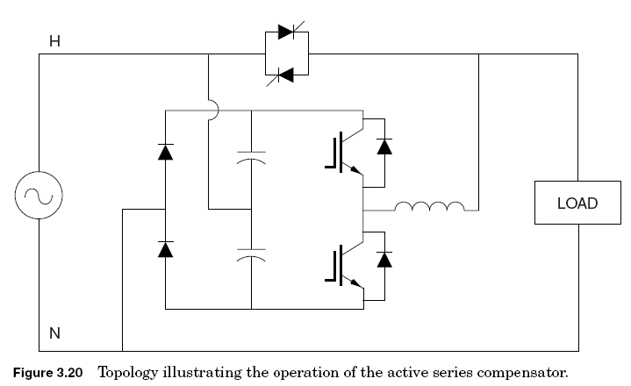
3. Active series compensators
Advances in power electronic technologies and new topologies for these devices have resulted in new options for providing voltage sag ridethrough support to critical loads.

Slide 28
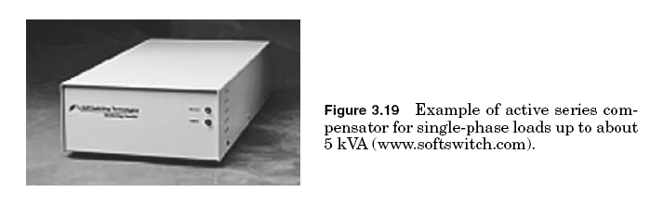
One of the important new options is a device that can boost the voltage by injecting a voltage in series with
the remaining voltage during a voltage sag condition. These are referred to as active series compensation devices. They are available in size ranges from small single-phase devices (1 to 5 kVA) to very large devices that can be applied on the medium-voltage systems (2 MVAand
larger).

Slide 29
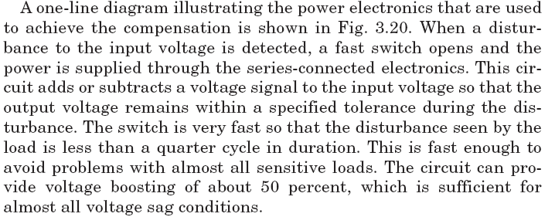

Slide 30
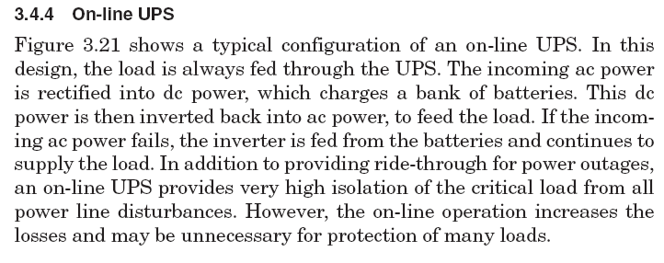
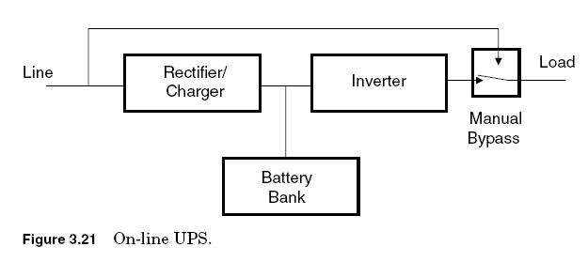

Slide 31
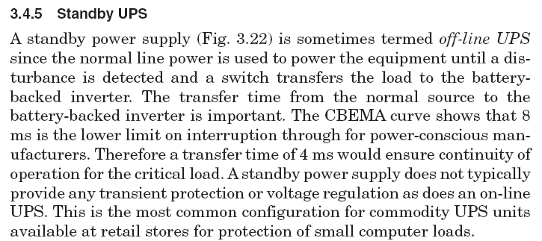
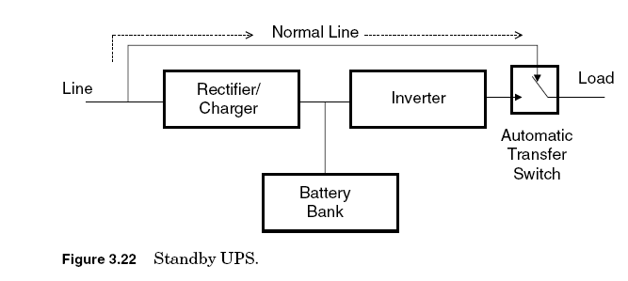
Standby UPS

Slide 32
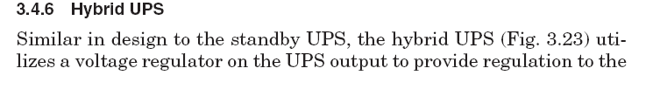

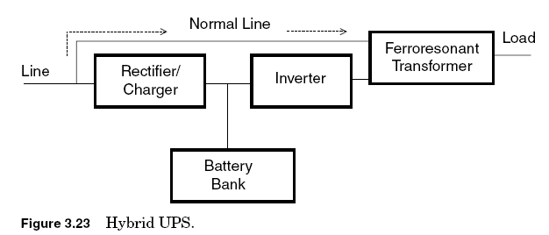

Slide 33
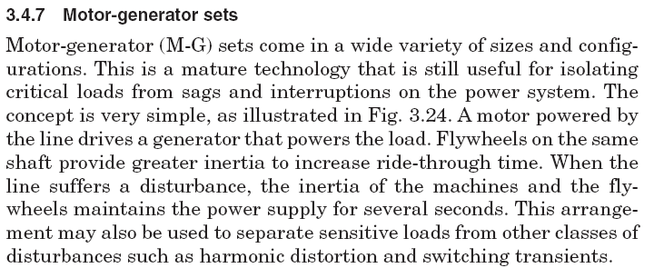
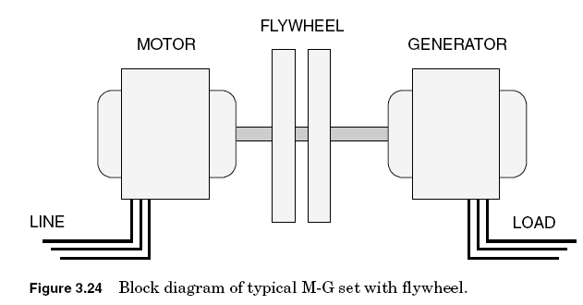

Slide 34
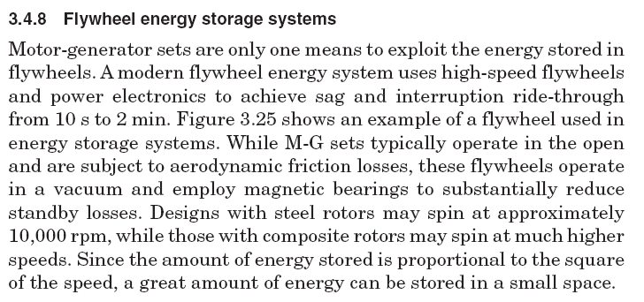

Slide 35
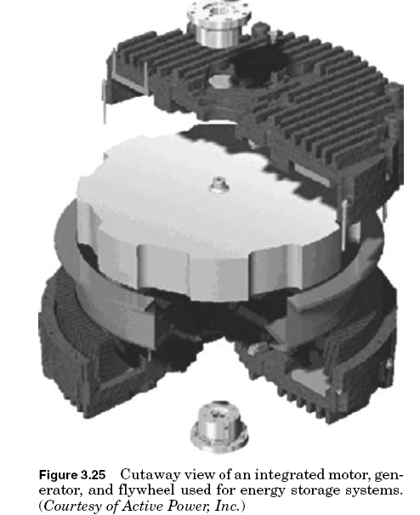

Slide 36
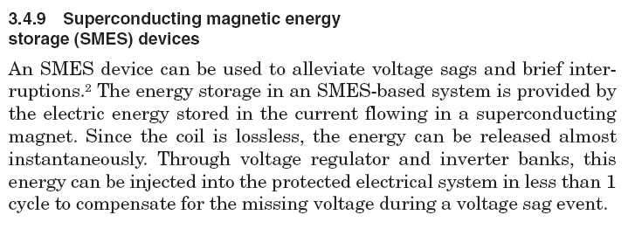

Slide 37
