Slide 1
Unit No.4
Fundamentals of Harmonics
Harmonic distortion – voltage and current distortion, power system quantities under non
sinusoidal condition – active, reactive and apparent power, power factor – displacement and true power factor, harmonic phase sequences and triplen harmonics, harmonic indices, sources of harmonics, effect of harmonic distortion

Slide 2
Harmonic distortion – voltage and current distortion
In most areas, the voltage found on transmission systems typically has much less than 1.0 percent distortion. However, the distortion increases closer to the load. At some loads, the current waveform barely resembles a sine wave.
While there are a few cases where the distortion is random, most distortion is periodic, or an integer multiple of the power system fundamental frequency. That is, the current waveform is nearly the same cycle after cycle, changing very slowly, if at all. This has given rise to the widespread use of the term harmonics to describe distortion of the waveform.

Slide 3
Harmonic Distortion
Harmonic distortion is caused by nonlinear devices in the power system.
A nonlinear device is one in which the current is not proportional to the applied voltage.

Slide 4
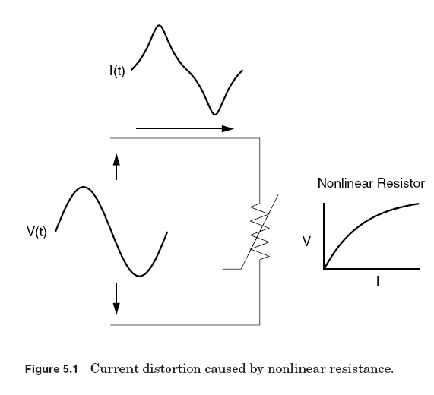
Figure illustrates this concept by the case of a sinusoidal voltage applied to a simple nonlinear resistor in which the voltage and current vary according to the curve shown. While the applied voltage is perfectly sinusoidal, the resulting current is distorted.

Slide 5
When a waveform is identical from one cycle to the next, it can be represented as a sum of pure sine waves in which the frequency of each sinusoid is an integer multiple of the fundamental frequency of the distorted wave. This multiple is called a harmonic of the fundamental, hence the name of this subject matter.
The sum of sinusoids is referred to as a Fourier series, named after the great mathematician who discovered the concept.
When both the positive and negative half cycles of a waveform have identical shapes, the Fourier series contains only odd harmonics. This offers a further simplification for most power system studies because most common harmonic-producing devices look the same to both polarities.

Slide 6
Because of the above property, the Fourier series concept is universally applied in analyzing harmonic problems.
The system can now be analyzed separately at each harmonic. In addition, finding the system response of a sinusoid of each harmonic individually is much more straightforward compared to that with the entire distorted waveforms.

Slide 7
When both the positive and negative half cycles of a waveform have identical shapes, the Fourier series contains only odd harmonics.
This offers a further simplification for most power system studies because most common harmonic-producing devices look the same to both polarities.
In fact, the presence of even harmonics is often a clue that there is something wrong—either with the load equipment or with the transducer used to make the measurement.

Slide 8
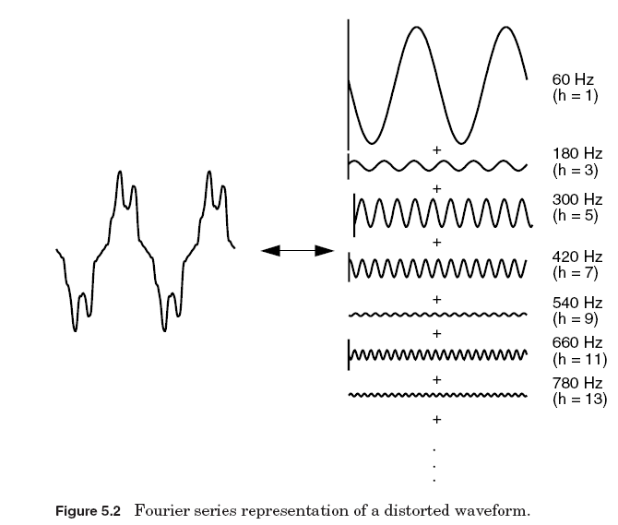
Usually, the higher-order harmonics (above the range of the 25th to 50th, depending on the system) are negligible for power system
analysis. While they may cause interference with low-power electronic devices, they are usually not damaging to the power system.

Slide 9
It is also difficult to collect sufficiently accurate data to model power systems at these frequencies. A common exception to this occurs when there are system resonances in the range of frequencies.
These resonances can be excited by notching or switching transients in electronic power converters.
If the power system is depicted as series and shunt elements, as is the conventional practice, the vast majority of the nonlinearities in the system are found in shunt elements (i.e., loads).
The series impedance of the power delivery system (i.e., the short-circuit impedance between the source and the load) is remarkably linear.

Slide 10
In transformers, also, the source of harmonics is the shunt branch (magnetizing impedance) of the common “T” model; the leakage impedance is linear. Thus, the main sources of harmonic distortion will ultimately be end-user loads.
This is not to say that all end users who experience harmonic distortion will themselves have significant sources of harmonics, but that the harmonic distortion generally originates with some end-user’s load or combination of loads.

Slide 11
Voltage versus Current Distortion
The word harmonics is often used by itself without further qualification. For example, it is common to hear that an adjustable-speed drive or an induction furnace can’t operate properly because of harmonics. What does that mean? Generally, it could mean one of the following three things:
1. The harmonic voltages are too great (the voltage too distorted) for the control to properly determine firing angles.
2. The harmonic currents are too great for the capacity of some device in the power supply system such as a transformer, and the machine must be operated at a lower than rated power.
3. The harmonic voltages are too great because the harmonic currents produced by the device are too great for the given system condition.

Slide 12
Nonlinear loads appear to be sources of harmonic current in shunt with and injecting harmonic currents into the power system. For nearly all analyses, it is sufficient to treat these harmonic-producing loads simply as current sources.
As Fig. 5.3 shows, voltage distortion is the result of distorted current passing through the linear, series impedance of the power delivery system, although, assuming that the source bus is ultimately a pure sinusoid, there is a nonlinear load that draws a distorted current.
The harmonic currents passing through the impedance of the system cause a voltage drop for each harmonic. This results in voltage harmonics appearing at the load bus. The amount of voltage distortion depends on the impedance and the current. Assuming the load bus distortion stays within reasonable limits (e.g., less than 5 percent), the amount of harmonic current produced by the load is generally constant.

Slide 13
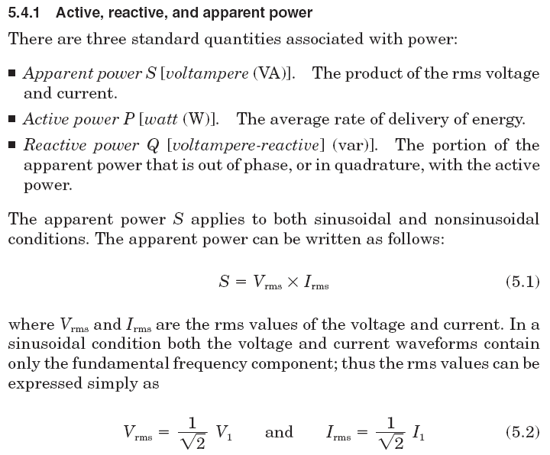
Power System Quantities under
Nonsinusoidal Conditions

Slide 14
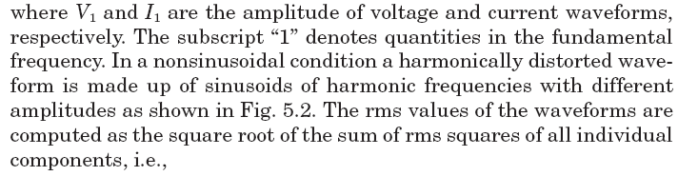
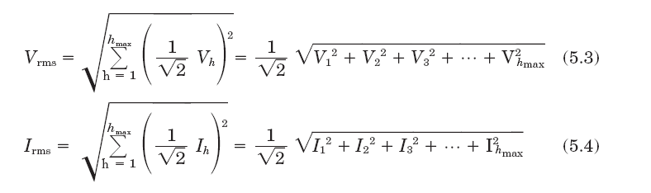
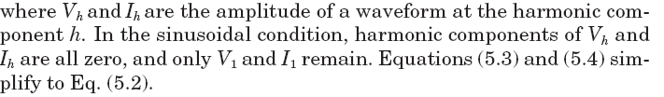

Slide 15

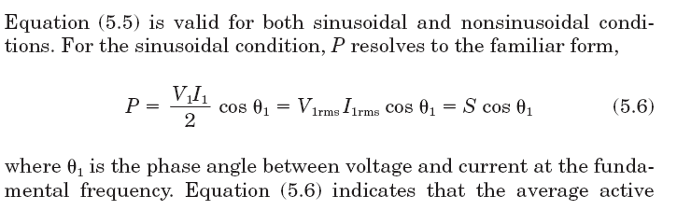
The active power P is also commonly referred to as the average power, real power, or true power. It represents useful power expended by loads to perform real work, i.e., to convert electric energy to other forms of energy. Real work performed by an incandescent light bulb is to convert electric energy into light and heat. In electric power, real work is performed for the portion of the current that is in phase with the voltage.
No real work will result from the portion where the current is not in phase with the voltage. The active power is the rate at which energy is expended, dissipated, or consumed by the load and is measured in units of watts. P can be computed by averaging the product of the instantaneous voltage and current, i.e.,

Slide 16
power is a function only of the fundamental frequency quantities.
In the nonsinusoidal case, the computation of the active power must include contributions from all harmonic components; thus it is the sum of active power at each harmonic.
Furthermore, because the voltage distortion is generally very low on power systems (less than 5 percent), Eq. (5.6) is a good approximation regardless of how distorted the current is.
This approximation cannot be applied when computing the apparent and reactive power. These two quantities are greatly influenced by the distortion. The apparent power S is a measure of the potential impact of the load on the thermal capability of the system. It is proportional to the rms of the distorted current, and its computation is straightforward, although slightly more complicated than the sinusoidal case. Also, many current probes can now directly report the true rms value of a distorted waveform.

Slide 17
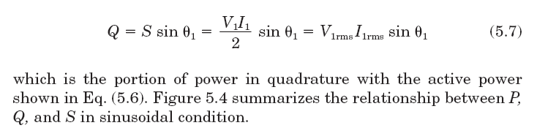
The reactive power is a type of power that does no real work and is generally associated with reactive elements (inductors and capacitors).
For example, the inductance of a load such as a motor causes the load current to lag behind the voltage. Power appearing across the inductance sloshes back and forth between the inductance itself and the power system source, producing no net work. For this reason it is called imaginary or reactive power since no power is dissipated or expended.
It is expressed in units of vars. In the sinusoidal case, the reactive power is simply defined as

Slide 18
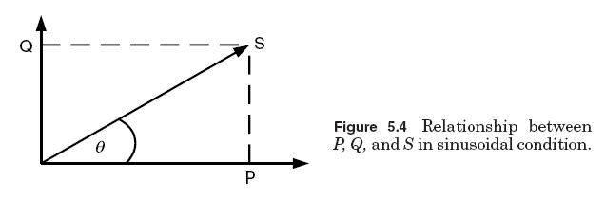
The reactive power when distortion is present has another interesting peculiarity. In fact, it may not be appropriate to call it reactive power.
The concept of var flow in the power system is deeply ingrained in the minds of most power engineers. What many do not realize is that this concept is valid only in the sinusoidal steady state.
When distortion is present, the component of S that remains after P is taken out is not conserved—that is, it does not sum to zero at a node. Power quantities are presumed to flow around the system in a conservative manner.

Slide 19
This does not imply that P is not conserved or that current is not conserved because the conservation of energy and Kirchoff’s current laws are still applicable for any waveform. The reactive component actually sum in quadrature (square root of the sum of the squares).
This has prompted some analysts to propose that Q be used to denote the reactive components that are conserved and introduce a new quantity for the components that are not. Many call this quantity D, for distortion power or, simply, distortion voltamperes.
It has units of voltamperes, but it may not be strictly appropriate to refer to this quantity as power, because it does not flow through the system as power is assumed to do. In this concept, Q consists of the sum of the traditional reactive power values at each frequency.

Slide 20
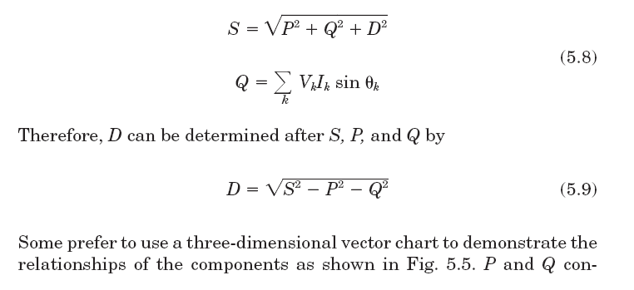
D represents all cross products of voltage and current at different frequencies, which yield no average power. P, Q, D, and S are related as follows, using the definitions for S and P previously given in Eqs. (5.1) and (5.5) as a starting point:
tribute the traditional sinusoidal components to S, while D represents
the additional contribution to the apparent power by the harmonics.

Slide 21
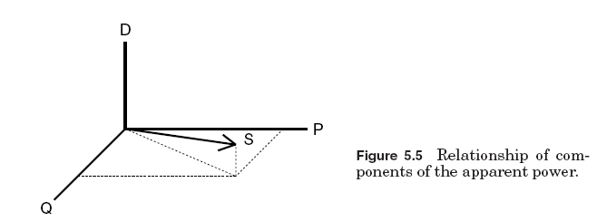
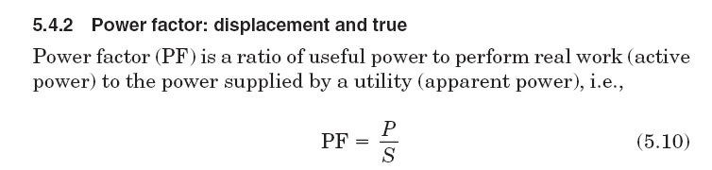

Slide 22
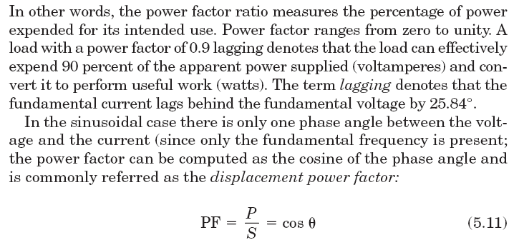
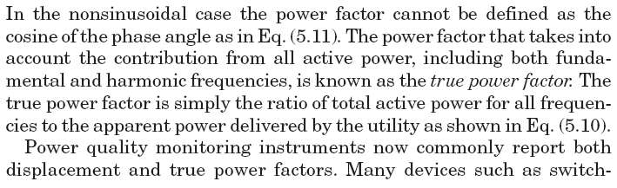

Slide 23
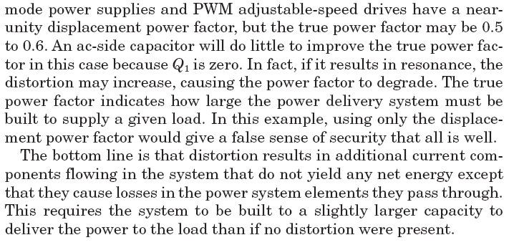

Slide 24
Harmonic phase sequences
The three-phase system is transformed into three single-phase systems that are much simpler to analyze.
The method of symmetrical components can be employed for analysis of the system’s response to harmonic currents provided care is taken not to violate the fundamental assumptions of the method.
The method allows any unbalanced set of phase currents (or voltages) to be transformed into three balanced sets. The positive-sequence set contains three sinusoids displaced 120° from each other, with the normal A-B-C phase rotation (e.g., 0°, 120°, 120°).
The sinusoids of the negative-sequence set are also displaced 120°, but have opposite phase rotation (A-C-B, e.g., 0°, 120°, 120°). The sinusoids of the zerosequence are in phase with each other (e.g., 0°, 0°, 0°).

Slide 25
In a perfect balanced three-phase system, the harmonic phase sequence can be determined by multiplying the harmonic number h with the normal positive-sequence phase rotation. For example, for the second harmonic, h2, we get 2 (0,120°, 120°) or (0°, 120°, 120°), which is the negative sequence. For the third harmonic, h 3, we get 3 (0°, 120°, 120°) or (0°, 0°, 0°), which is the zero sequence. Phase sequences for all other harmonic orders can be determined in the same fashion.
Since a distorted waveform in power systems contains only odd-harmonic components (see Sec. 5.1), only odd-harmonic phase sequence rotations are summarized here:
■ Harmonics of order h 1, 7, 13,… are generally positive sequence.
■ Harmonics of order h 5, 11, 17,… are generally negative sequence.
■ Triplens (h 3, 9, 15,…) are generally zero sequence.

Slide 26
Triplen harmonics
As previously mentioned, triplen harmonics are the odd multiples of the third harmonic (h 3, 9, 15, 21,…). They deserve special consideration because the system response is often considerably different for triplens than for the rest of the harmonics. Triplens become an important issue for grounded-wye systems with current flowing on the neutral.
Two typical problems are overloading the neutral and telephone interference. One also hears occasionally of devices that misoperate because the line-to-neutral voltage is badly distorted by the triplen harmonic voltage drop in the neutral conductor.

Slide 27
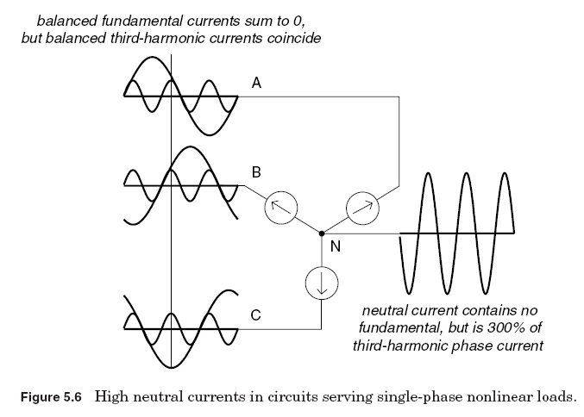
For the system with perfectly balanced single-phase loads illustrated in Fig. 5.6, an assumption is made that fundamental and third-harmonic components are present.
Summing the currents at node N, the fundamental current components in the neutral are found to be zero, but the third-harmonic components are 3 times those of the phase currents because they naturally coincide in phase and time.

Slide 28
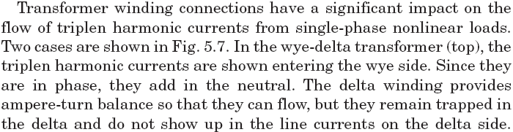
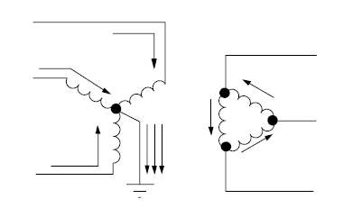

Slide 29
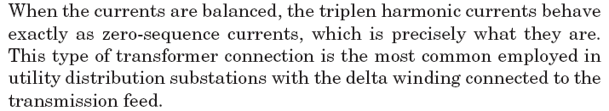

Slide 30
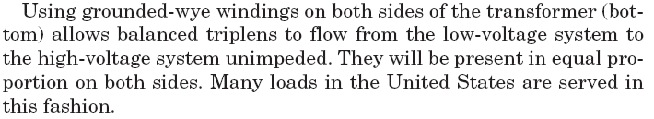
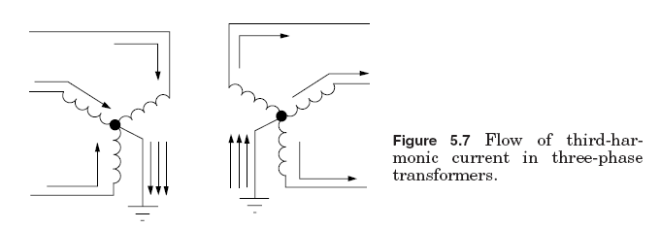

Slide 31
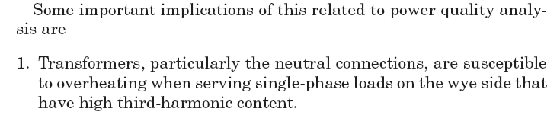
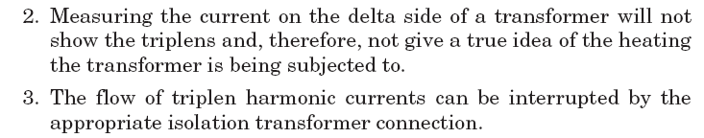

Slide 32
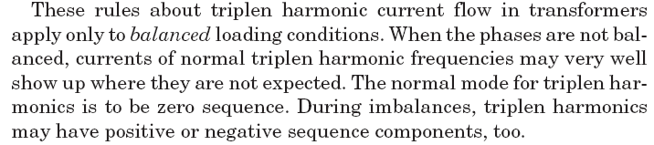

Slide 33
Harmonic Indices
The two most commonly used indices for measuring the harmonic content of a waveform are the total harmonic distortion and the total demand distortion. Both are measures of the effective value of a waveform and may be applied to either voltage or current.

Slide 34
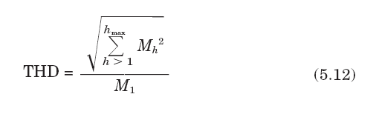
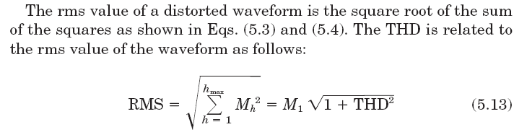
Total harmonic distortion
The THD is a measure of the effective value of the harmonic components of a distorted waveform.
This index can be calculated for either voltage or current:
where Mh is the rms value of harmonic component h of the quantity M.

Slide 35
The THD index is most often used to describe voltage harmonic distortion. Harmonic voltages are almost always referenced to the fundamental value of the waveform at the time of the sample. Because fundamental voltage varies by only a few percent, the voltage THD is nearly always a meaningful number.
Variations in the THD over a period of time often follow a distinct pattern representing nonlinear load activities in the system.
Figure 5.9 shows the voltage THD variation over a 1-week period where a daily cyclical pattern is obvious. The voltage THD shown in Fig. 5.9 was taken at a 13.2-kV distribution substation supplying a residential load.

Slide 36
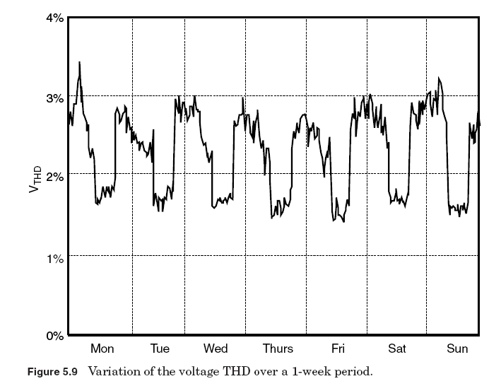

Slide 37
High-voltage THD occurs at night and during the early morning hours since the nonlinear loads are relatively high compared to the amount of linear load during these hours. A 1-week observation period is often required to come up with a meaningful THD pattern since it is usually the shortest period to obtain representative and reproducible measurement results.

Slide 38
Total demand distortion
Current distortion levels can be characterized by a THD value, as has been described, but this can often be misleading. A small current may have a high THD but not be a significant threat to the system. For example, many adjustable-speed drives will exhibit high THD values for the input current when they are operating at very light loads. This is not necessarily a significant concern because the magnitude of harmonic current is low, even though its relative current distortion is high.
Some analysts have attempted to avoid this difficulty by referring THD to the fundamental of the peak demand load current rather than the fundamental of the present sample. This is called total demand distortion and serves as the basis for the guidelines in IEEE Standard 519-1992, Recommended Practices and Requirements for Harmonic Control in Electrical Power Systems. It is defined as follows:

Slide 39
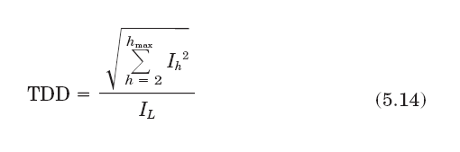
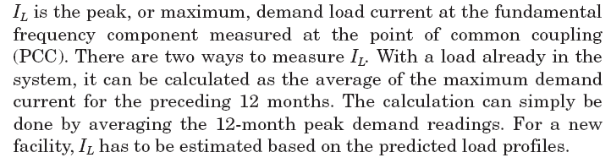

Slide 40
Harmonic Sources from
Commercial Loads
Commercial facilities such as office complexes, department stores, hospitals, and Internet data centers are dominated with high-efficiency fluorescent lighting with electronic ballasts, adjustable-speed drives for the heating, ventilation, and air conditioning (HVAC) loads, elevator drives, and sensitive electronic equipment supplied by single-phase switch-mode power supplies.

Slide 41
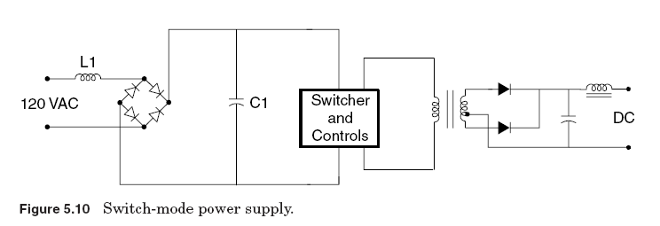
1. Single-phase power supplies
A major concern in commercial buildings is that power supplies for single-phase electronic equipment will produce too much harmonic current for the wiring. DC power for modern electronic and microprocessor-based office equipment is commonly derived from single-phase full-wave diode bridge rectifiers.

Slide 42
There are two common types of single-phase power supplies. Older technologies use ac-side voltage control methods, such as transformers, to reduce voltages to the level required for the dc bus. The inductance of the transformer provides a beneficial side effect by smoothing the input current waveform, reducin harmonic content. Newer-technology switch-mode power supplies (see Fig. 5.10) use dc-to-dc conversion techniques to achieve a smooth dc output with small, lightweight components.
A distinctive characteristic of switch-mode power supplies is a very high third-harmonic content in the current. Since third-harmonic current components are additive in the neutral of a three-phase system, the increasing application of switch-mode power supplies causes concern for overloading of neutral conductors, especially in older buildings where an undersized neutral may have been installed

Slide 43
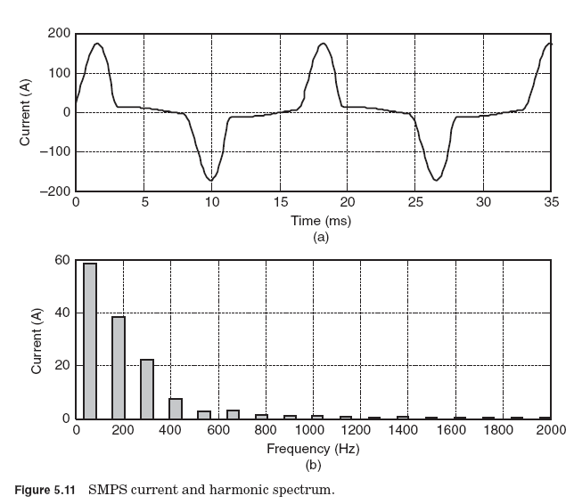

Slide 44
2. Fluorescent lighting
Lighting typically accounts for 40 to 60 percent of a commercial building load.
Fluorescent lights are discharge lamps; thus they require a ballast to provide a high initial voltage to initiate the discharge for the electric current to flow between two electrodes in the fluorescent tube.
Once the discharge is established, the voltage decreases as the arc current increases. It is essentially a short circuit between the two electrodes, and the ballast has to quickly reduce the current to a level to maintain the specified lumen output. Thus, a ballast is also a current-limiting device in lighting applications.

Slide 45
An electronic ballast employs a switch-mode–type power supply to convert the incoming fundamental frequency voltage to a much higher frequency voltage typically in the range of 25 to 40 kHz. This high frequency has two advantages. First, a small inductor is sufficient to limit the arc current. Second, the high frequency eliminates or greatly reduces the 100- or 120-Hz flicker associated with an iron-core magnetic ballast. A single electronic ballast typically can drive up to four fluorescent lamps.

Slide 46
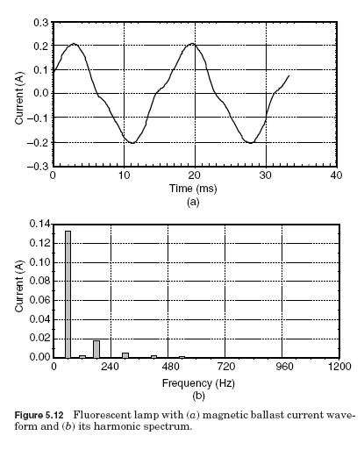

Slide 47
As a comparison, electronic ballasts, which employ switch-mode power supplies, can produce double or triple the standard magnetic ballast harmonic output. Figure 5.13 shows a fluorescent lamp with an electronic ballast that has a current THD of 144.

Slide 48
Adjustable-speed drives for HVAC and elevators
Common applications of adjustable-speed drives (ASDs) in commercial loads can be found in elevator motors and in pumps and fans in HVAC systems.
An ASD consists of an electronic power converter that converts ac voltage and frequency into variable voltage and frequency.
The variable voltage and frequency allows the ASD to control motor speed to match the application requirement such as slowing a pump or fan.
ASDs also find many applications in industrial loads.

Slide 49
Harmonic Sources from
Industrial Loads
Modern industrial facilities are characterized by the widespread application of nonlinear loads. These loads can make up a significant portion of the total facility loads and inject harmonic currents into the power system, causing harmonic distortion in the voltage.
This harmonic problem is compounded by the fact that these nonlinear loads have a relatively low power factor. Industrial facilities often utilize capacitor banks to improve the power factor to avoid penalty charges.
The application of power factor correction capacitors can potentially magnify harmonic currents from the nonlinear loads, giving rise to resonance conditions within the facility.

Slide 50
Three-phase power converters
Three-phase electronic power converters differ from single-phase converters mainly because they do not generate third-harmonic currents.
This is a great advantage because the third-harmonic current is the largest component of harmonics. However, they can still be significant sources of harmonics at their characteristic frequencies, as shown in Fig. 5.14. This is a typical current source type of adjustable-speed drive.
The harmonic spectrum given in Fig. 5.14 would also be typical of a dc motor drive input current. Voltage source inverter drives (such as PWM-type drives) can have much higher distortion levels as shown in Fig. 5.15.

Slide 51
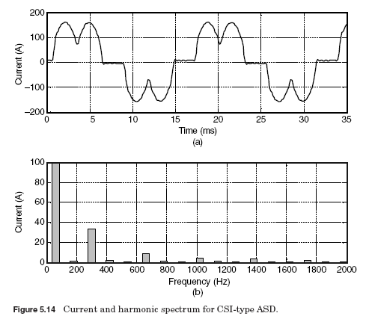

Slide 52
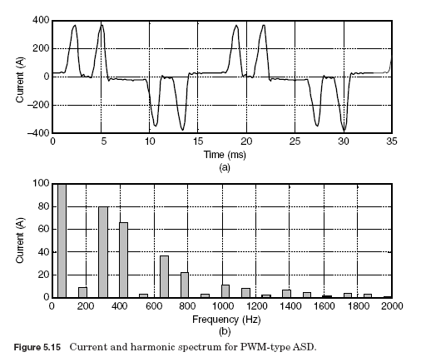

Slide 53
DC drives.
Rectification is the only step required for dc drives.
Therefore, they have the advantage of relatively simple control systems. Compared with ac drive systems, the dc drive offers a wider speed range and higher starting torque. However, purchase and maintenance costs for dc motors are high, while the cost of power electronic devices has been dropping year after year. Thus, economic considerations limit use of the dc drive to applications that require the speed and torque characteristics of the dc motor.
Most dc drives use the six-pulse rectifier shown in Fig. 5.16. Large drives may employ a 12-pulse rectifier. This reduces thyristor current duties and reduces some of the larger ac current harmonics.

Slide 54
The two largest harmonic currents for the six-pulse drive are the fifth and seventh.
They are also the most troublesome in terms of system response. A 12-pulse rectifier in this application can be expected to eliminate about 90 percent of the fifth and seventh harmonics, depending on system imbalances. The disadvantages of the 12-pulse drive are that there is more cost in electronics and another transformer is generally required.

Slide 55
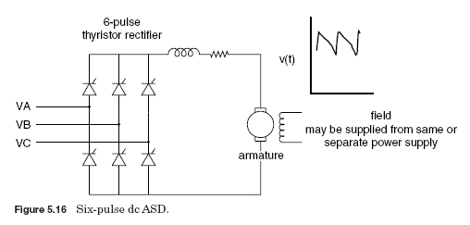

Slide 56
AC drives
In ac drives, the rectifier output is inverted to produce a variable-frequency ac voltage for the motor. Inverter are classified as voltage source inverters (VSIs) or current source inverters (CSIs).
A VSI requires a constant dc (i.e., low-ripple) voltage input to the inverter stage. This is achieved with a capacitor or LC filter in the dc link. The CSI requires a constant current input; hence, a series inductor is placed in the dc link.

Slide 57
AC drives generally use standard squirrel cage induction motors.
These motors are rugged, relatively low in cost, and require little maintenance. Synchronous motors are used where precise speed control is critical.
A popular ac drive configuration uses a VSI employing PWM techniques to synthesize an ac waveform as a train of variable-width dc pulses (see Fig. 5.17). The inverter uses either SCRs, gate turnoff (GTO) thyristors, or power transistors for this purpose.

Slide 58
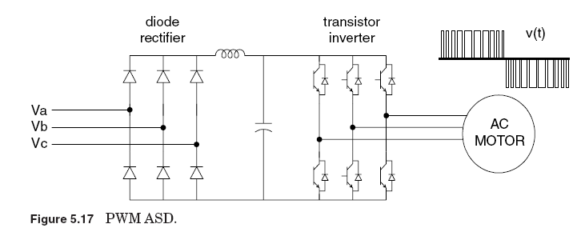

Slide 59
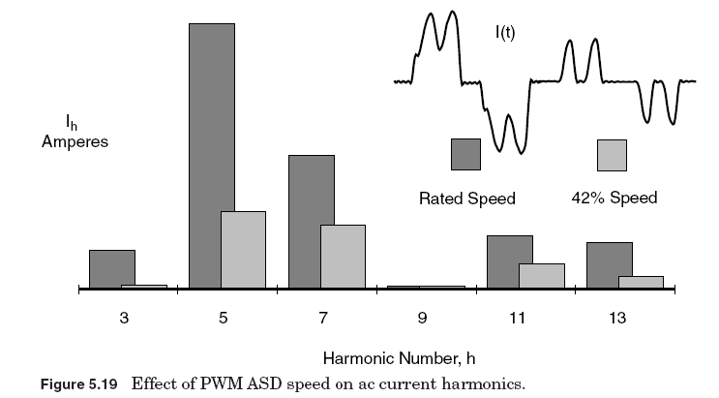

Slide 60
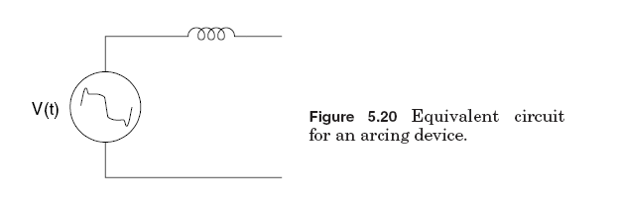
Arcing devices
This category includes arc furnaces, arc welders, and discharge-type lighting (fluorescent, sodium vapor, mercury vapor) with magnetic (rather than electronic) ballasts. As shown in Fig. 5.20, the arc is basically a voltage clamp in series with a reactance that limit current to a reasonable value.

Slide 61
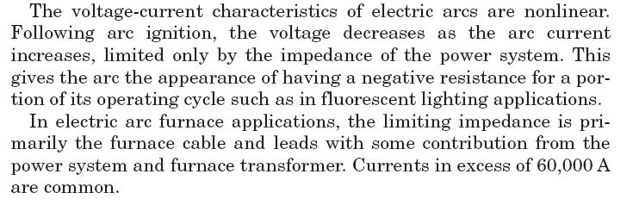

Slide 62
Saturable devices
Equipment in this category includes transformers and other electromagnetic devices with a steel core including motors. Harmonics are generated due to the nonlinear magnetizing characteristics of the steel (see Fig. 5.21).

Slide 63
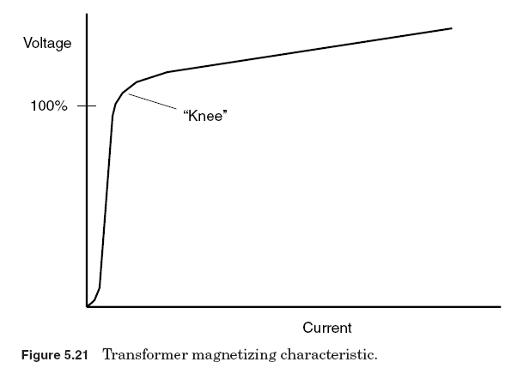

Slide 64
Power transformers are designed to normally operate just below the “knee” point of the magnetizing saturation characteristic. The operating flux density of a transformer is selected based on complicated optimization of steel cost, no-load losses, noise, and numerous other factors.
Many electric utilities will penalize transformer vendors by various amounts for no-load and load losses, and the vendor will try to meet the specification with a transformer that has the lowest evaluated cost.

Slide 65
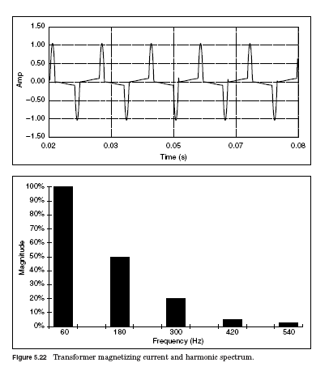

Slide 66
Effects of Harmonic Distortion
Harmonic currents produced by nonlinear loads are injected back into the supply systems. These currents can interact adversely with a wide range of power system equipment, most notably capacitors transformers, and motors, causing additional losses, overheating, and overloading.
These harmonic currents can also cause interference with telecommunication lines and errors in power metering.

Slide 67
Impact on capacitors
Problems involving harmonics often show up at capacitor banks first.
A capacitor bank experiences high voltage distortion during resonance. The current flowing in the capacitor bank is also significantly large and rich in a monotonic harmonic.
Figure 5.32 shows a current waveform of a capacitor bank in resonance with the system at the 11th harmonic.

Slide 68
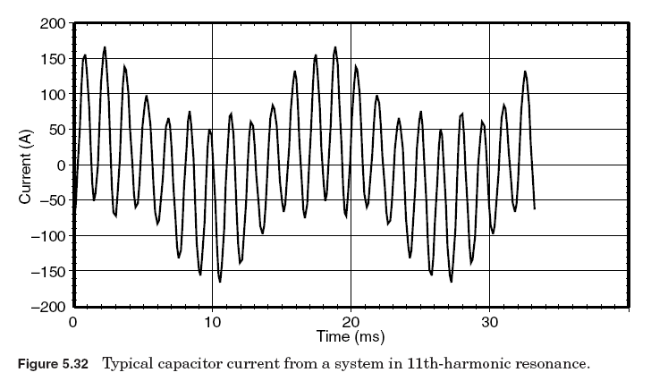

Slide 69
Impact on transformers
Transformers are designed to deliver the required power to the connected loads with minimum losses at fundamental frequency.
Harmonic distortion of the current, in particular, as well as of the voltage will contribute significantly to additional heating. To design a transformer to accommodate higher frequencies, designers make different design choices such as using continuously transposed cable instead of solid conductor and putting in more cooling ducts.
As a general rule, a transformer in which the current distortion exceeds 5 percent is a candidate for derating for harmonics.

Slide 70
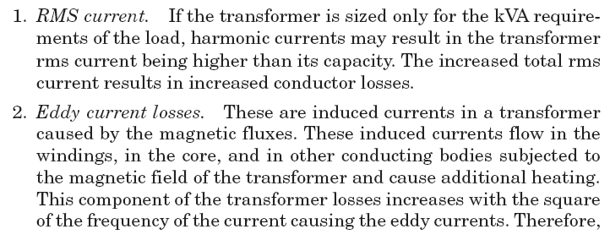
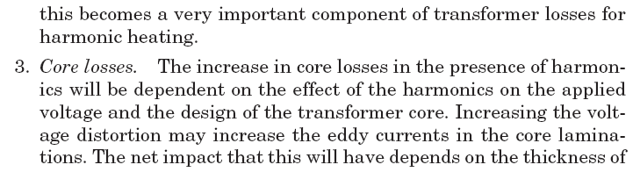
There are three effects that result in increased transformer heating when the load current includes harmonic components:

Slide 71


Slide 72
Impact on motors
Motors can be significantly impacted by the harmonic voltage distortion.
Harmonic voltage distortion at the motor terminals is translated into harmonic fluxes within the motor. Harmonic fluxes do not contribute significantly to motor torque, but rotate at a frequency different than the rotor synchronous frequency, basically inducing high-frequency currents in the rotor.
The effect on motors is similar to that of negative-sequence currents at fundamental frequency: The additional fluxes do little more than induce additional losses. Decreased efficiency along with heating, vibration, and high-pitched noises are indicators of harmonic voltage distortion.

Slide 73
Impact on telecommunications
Harmonic currents flowing on the utility distribution system or within an end-user facility can create interference in communication circuits sharing a common path. Voltages induced in parallel conductors by the common harmonic currents often fall within the bandwidth of normal voice communications. Harmonics between 540 (ninth harmonic) and 1200 Hz are particularly disruptive.
The induced voltage per ampere of current increases with frequency. Triplen harmonics (3d, 9th, 15th) are especially troublesome in four-wire systems because they are in phase in all conductors of a three-phase circuit and, therefore, add directly in the neutral circuit, which has the greatest exposure with the communications circuit.

Slide 74
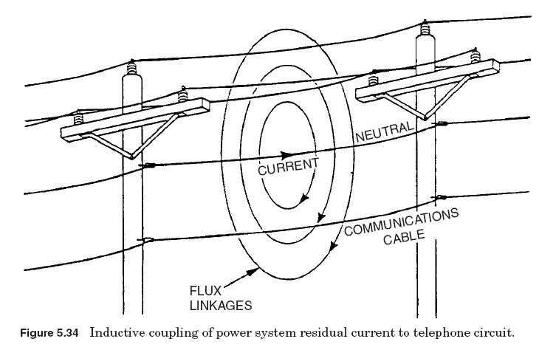

Slide 75
Impact on energy and demand metering
Electric utility companies usually measure energy consumption in two quantities: the total cumulative energy consumed and the maximum power used for a given period. Thus, there are two charges in any given billing period especially for larger industrial customers: energy charges and demand charges. Residential customers are typically charged for the energy consumption only. The energy charge represents the costs of producing and supplying the total energy consumed over a billing period and is measured in kilowatt-hours. The second part of the bill, the demand charge, represents utility costs to maintain adequate elec

Slide 76
trical capacity at all times to meet each customer’s peak demand for energy use. The demand charge reflects the utility’s fixed cost in providing peak power requirements. The demand charge is usually determined by the highest 15- or 30-min peak demand of use in a billing period and is measured in kilowatts.

Slide 77
Both energy and demand charges are measured using the so-called watthour and demand meters. Ademand meter is usually integrated to a watthour meter with a timing device to register the peak power use and returns the demand pointer to zero at the end of each timing interval (typically 15 or 30 min).
Harmonic currents from nonlinear loads can impact the accuracy of watthour and demand meters adversely. Traditional watthour meters are based on the induction motor principle. The rotor element or the rotating disk inside the meter revolves at a speed proportional to the power flow. This disk in turn drives a series of gears that move dials on a register.

Slide 78
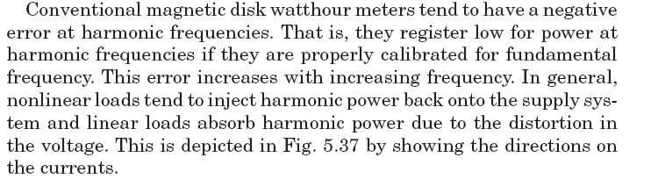
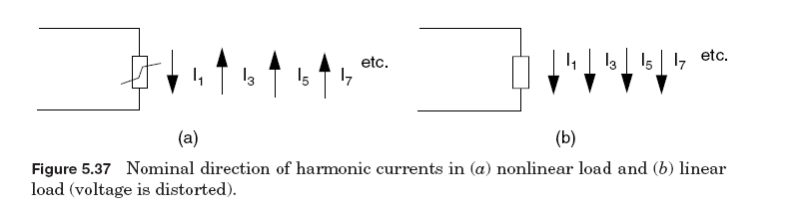

Slide 79
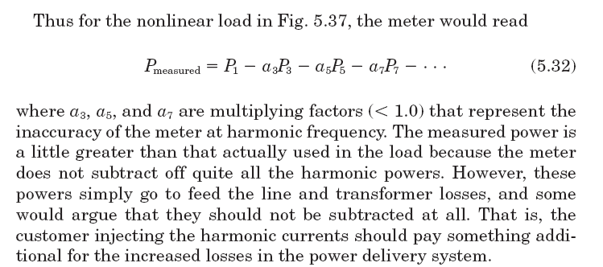

Slide 80
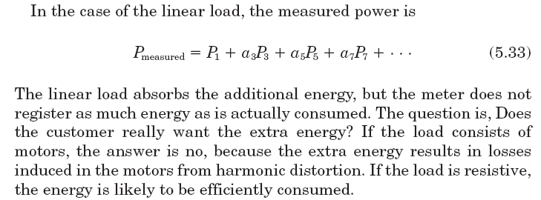

Slide 81
Thank You
Thank You
Thank You

