Slide 1
Unit No.6
Fundamentals of Harmonics
Unit 06 : Measuring and solving power quality problems (6 hrs)
Introduction, power quality measurement devices – harmonic analyzer, transient disturbance analyzer, oscilloscopes, data loggers and chart recorders, true rms meters, power quality measurements, number of test location, test duration, instrument setup and guidelines.

Slide 2
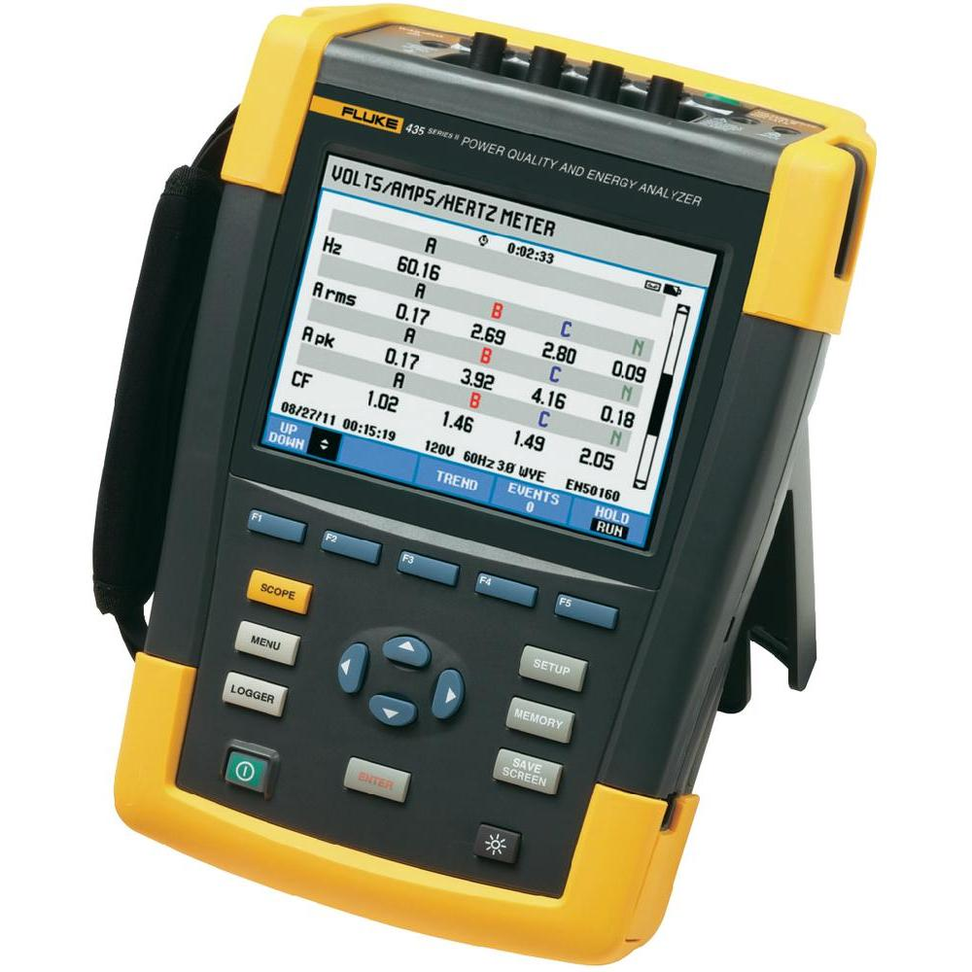
Harmonic analyzer

Slide 3
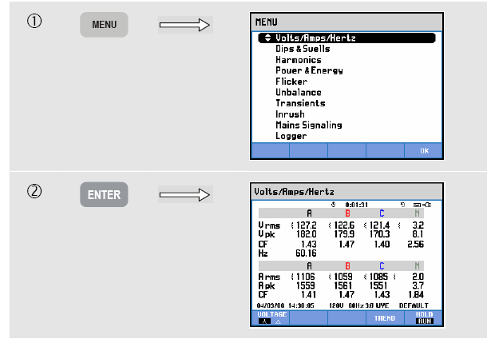
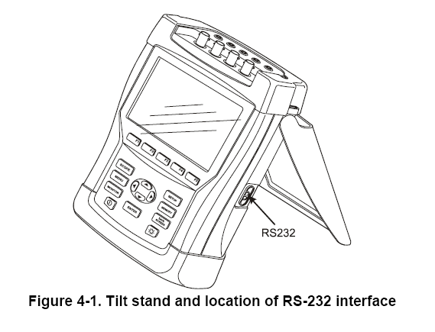
Fluke 434-II series
Power Quality Analyser

Slide 4
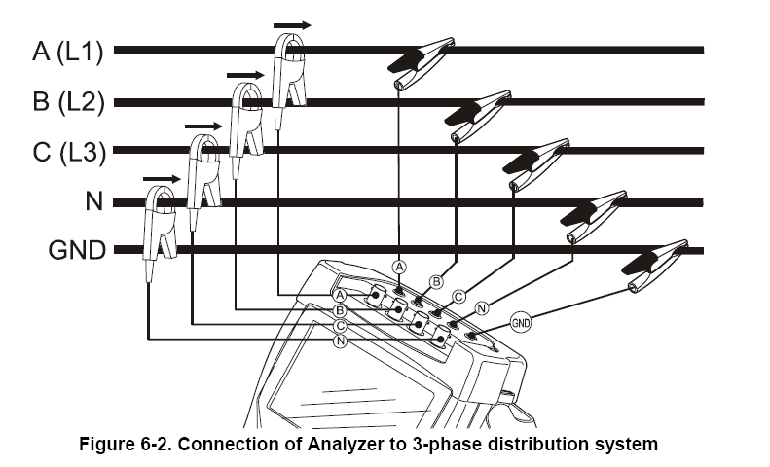
Connections

Slide 5
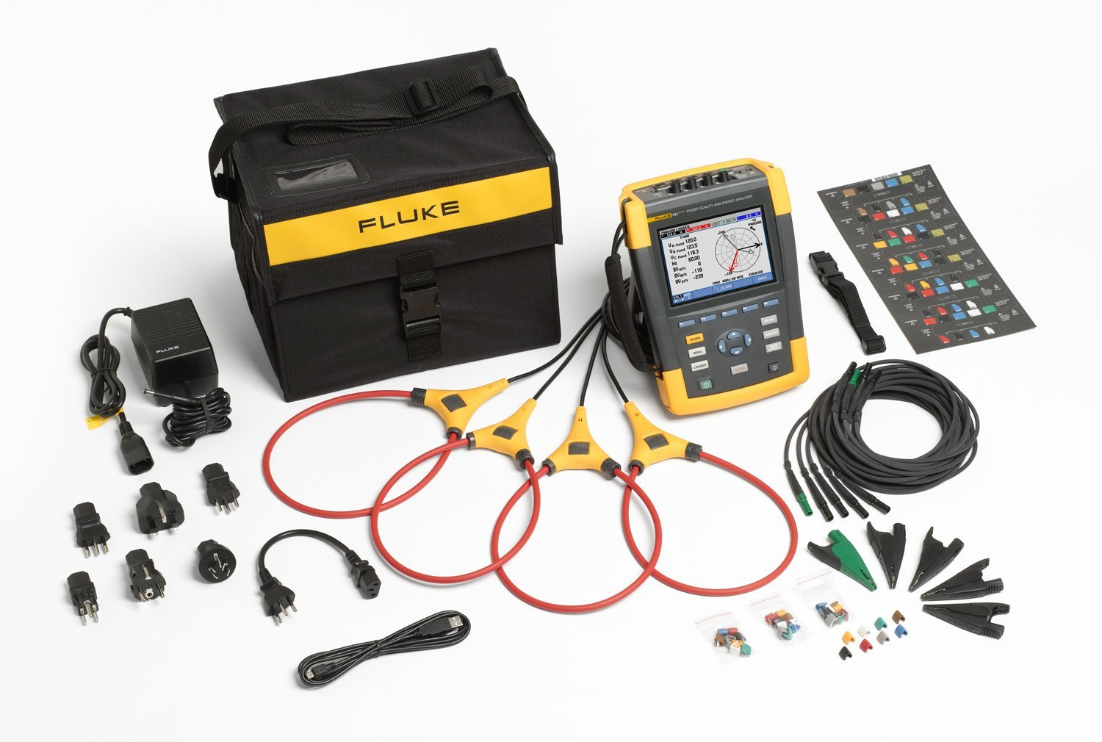

Slide 6
VOLTS/AMPS/HERTZ Mode
The Meter screen gives an overview of voltages and currents in all phases. Also frequency and Crest Factors are shown. The Crest Factor CF indicates the amount of distortion: a CF of 1.41 means no distortion and higher than 1.8 means high distortion.
Use this screen to get a first impression of power syste performance before examining the system in detail with other measuring modes. The number of columns in the Meter screen depends on the power system configuration.

Slide 7
Dips & Swells
Dips & Swells records Dips, Interruptions, Rapid Voltage Changes, and Swells.
Dips (Sags) and Swells are fast deviations from the normal voltage. Magnitude may be ten up to hundreds of volts. Duration may vary from a half cycle to a few seconds as defined in EN61000-4-30. The Analyzer allows you to choose nominal or sliding reference voltage. A sliding reference voltage uses measured values filtered with a 1- minute time constant.
During a dip the voltage drops; during a swell the voltage rises. In three phase systems a dip begins when the voltage on one or more phases drops below the dip threshold and ends when all phases are equal to or above the dip threshold plus hysteresis. The trigger conditions for dips and swells are threshold and hysteresis. Dips and swells are characterized by duration, magnitude, and time of occurrence. Figure 9-1 and 9-2 explain this.

Slide 8
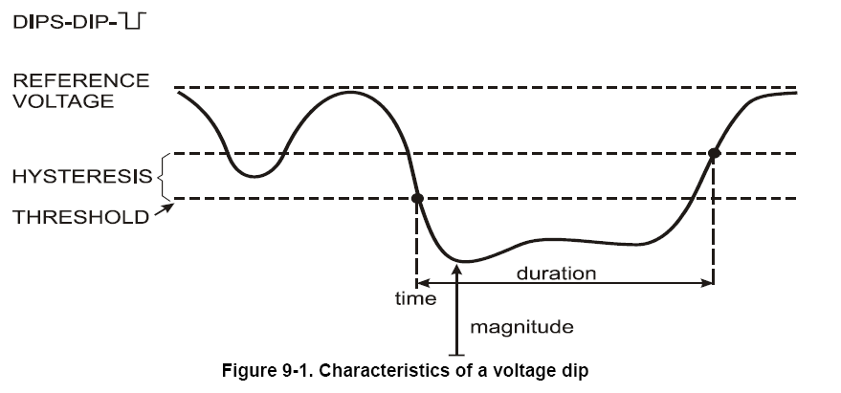

Slide 9
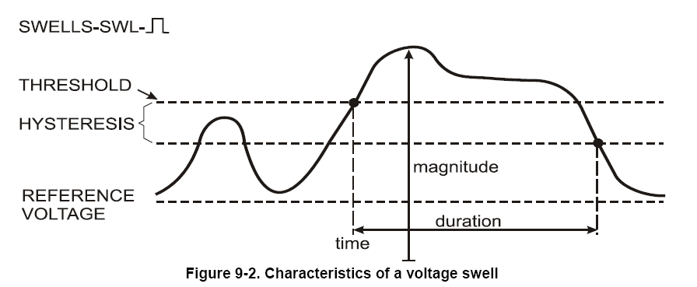

Slide 10
Harmonics
Harmonics measures and records harmonics and interharmonics up to the 50th. Related data such as DC components, THD (Total Harmonic Distortion), and K-factor are measured. Harmonics are periodic distortions of voltage, current, or power sinewaves.
A waveform can be considered as a combination of various sinewaves with different frequencies and magnitudes.

Slide 11
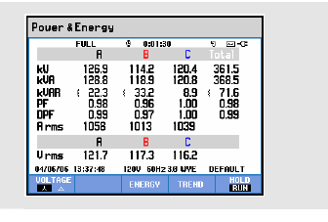
Power & Energy

Slide 12
The Meter screen displays power data for each phase and in total: real or active power(kW), apparent power (kVA, the product of rms voltage and current), reactive power (kVAR, the reactive component of apparent power caused by phase shift between AC current and voltage in inductors and capacitors), power factor (PF, the ratio of real power to apparent power for the total rms including harmonics), displacement power factor (DPF or cos ϕ, the ratio of real power to apparent power for fundamental), and the 12/10 or 180/150 cycle rms values of current and voltage.

Slide 13
Flicker
Flicker quantifies the luminance fluctuation of lamps caused by supply voltage variations.
The algorithm behind the measurement meets EN61000-4-15 and is based on a perceptual model of the human eye / brain sensory system.
The Analyzer converts duration and magnitude of voltage variations into an ‘annoyance factor’ caused by the resulting flicker of a 60 W lamp. A high flicker reading means that most people would find the luminance changes irritating. The voltage variation can be relatively small.

Slide 14
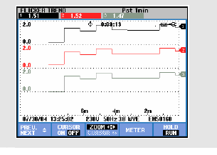

Slide 15
Flicker meters.
Generally, these meters can be divided up into three sections. In the first section the input waveform is demodulated, thus removing the carrier signal. As a result of the demodulator, a dc offset and higher-frequency terms (sidebands) are produced.
The second section removes these unwanted terms using filters, thus leaving only the modulating (flicker) signal remaining. The second section also consists of filters that weight the modulating signal according to the particular meter specifications.
The last section usually consists of a statistical analysis of the measured flicker.

Slide 16
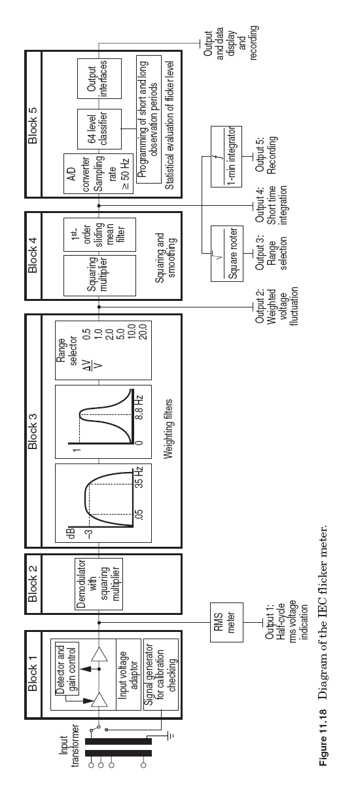

Slide 17
Smart power quality monitors
All power quality measurement instruments previously described are designed to collect power quality data. Some instruments can send the data over a telecommunication line to a central processing location for analysis and interpretation. However, one common feature among these instruments is that they do not possess the capability to locally analyze, interpret, and determine what is happening in the power system.
They simply record and transmit data for postprocessing. Since the conclusion of the EPRI DPQ project in Fall 1995, it was realized that these monitors, along with the monitoring practice previously described, were inadequate. An emerging trend in power quality monitoring practice is to collect the data, turn them into useful information, and disseminate it to users. All these processes take place within the instrument itself.

Slide 18
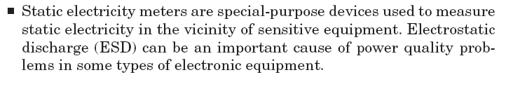
Infrared meters
Infrared meters can be very valuable in detecting loose connections and overheating conductors. An annual procedure of checking the system in this manner can help prevent power quality problems due to arcing, bad connections, and overloaded conductors.

Slide 19
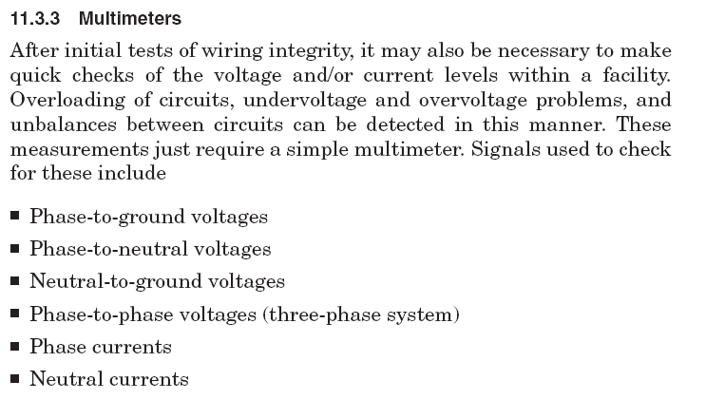

Slide 20
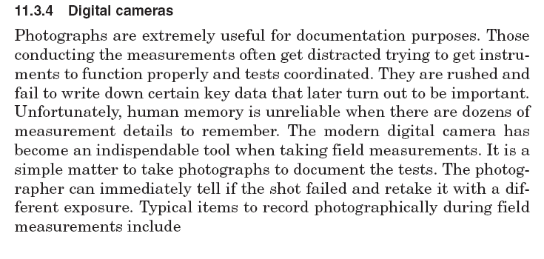

Slide 21
